Slide 1


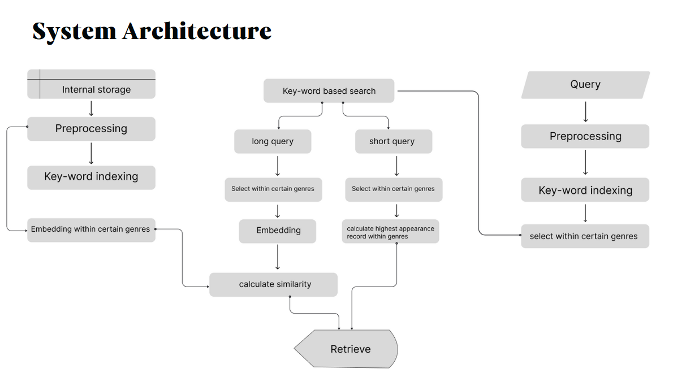




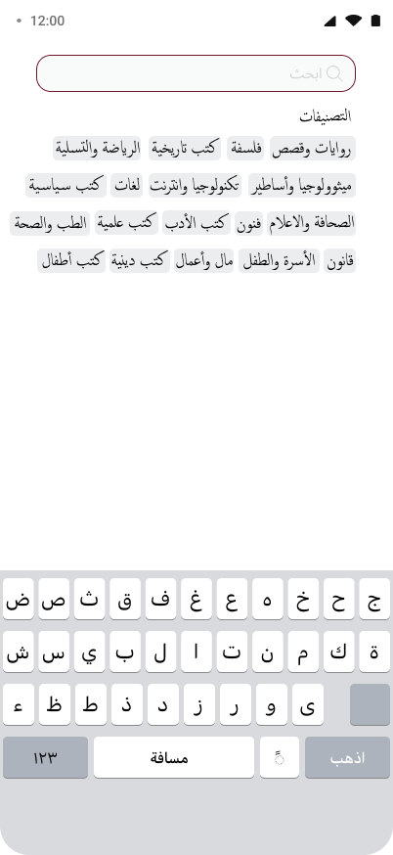
Arabic Books Search Engine
By: Mohamed Ahmed, Mohamed Sayed, Yousef Nasser, Mahmoud Mohamed
Abd Elrahman Mohamed, Kerolos Ashraf
Supervised by: Prof. Dr. Howida Shedeed, TA. Nouran Elsayed
Faculty of Computer and Information Sciences - Ain Shams University
Introduction
The dramatic growth of Arabic digital libraries, academic repositories, and online bookstores has amplified the need for advanced search systems that can handle the linguistic complexity and semantic richness of the Arabic language. Yet, most existing Arabic search engines still depend heavily on basic keyword-based retrieval methods, which are inherently limited in understanding the actual intent or contextual meaning behind a user's query.
Arabic presents unique challenges for information retrieval due to its:
Morphological complexity: Root-based word derivation causes significant variation in surface forms.
Ambiguity and synonymy: Multiple words can express the same concept depending on dialect, context, or domain ("انطلاق“,"حرية")
Flexible syntax: The position of words in a sentence can vary without changing the meaning.
Lack of robust Arabic NLP tools: Compared to English, fewer open-source libraries exist for effective Arabic language processing.
As a result, users often experience low-quality search results, especially when their queries are complex, abstract, or phrased differently from the book metadata.
Our Solution: A Hybrid Semantic-Keyword Search Engine
To address these limitations, we developed a hybrid Arabic book search engine that intelligently combines the efficiency of keyword-based retrieval with the depth of semantic search powered by machine learning. This hybrid strategy ensures accurate, meaningful, and context-aware search results for Arabic readers.
The system operates in two main phases:
Phase 1: keyword-Based searching
This phase significantly narrows the search space by filtering results within related genres or topics, which improves both speed and relevance.
If the query is short or contains rare keywords, this phase ensures that exact or high-frequency term matches are prioritized.
Phase 2: Semantic Similarity searching
In this phase, we compute contextualized embeddings for the user query and the most similar in book space within certain genre
Phase 3: Retrieval.
Cosine similarity is computed between the query and each document embedding to re-rank the results based on semantic closeness
This ensures that books are not only matched by words but by concepts, themes, and intent.
Figure 1 : System Architecture
Results
Figure 2:Startup Pages
Figure 3:Mobile App Home Page
Figure 4:Searching Bars
Methods
Figure 5: Similarity Scores
Our system follows a modular pipeline consisting of data collection, text processing, embedding generation, and similarity matching. Below is a breakdown:
Conclusions
Book Data Preparation
Data Collection and Preprocessing
Corpus: Over 32,000 Arabic books including title, description, and author name.
Preprocessing Steps
Text normalization (removing diacritics, non-Arabic characters)
Tokenization
Stop-word removal and light stemming
Keyword Indexing
Create an inverted index for faster filtering.
Embeddings using sentence transformer
Query Processing
The user Query goes through similar Preprocessing and Keyword Indexing steps.
A decision is made based on the query length:
Short queries rely on keyword frequency and select the most relevant records within a genre based on term appearance.
Long queries are passed to the embedding layer after performing key-word based search , , and similarity is computed between the query and all retrieved candidate books.
In both cases, the results are filtered by genre to increase relevance.
Similarity & Retrieval
For long queries, cosine similarity is used between the query embedding and the indexed book embeddings.
The system then retrieves the top-k most semantically similar books.
This project successfully demonstrates that semantic search engines for Arabic text can outperform traditional keyword-based systems when using advanced embedding techniques. The key findings include:
Pre-trained contextual models like AraBERT significantly improve retrieval accuracy for Arabic due to their understanding of language structure, morphology, and context.
Embedding quality directly affects user satisfaction in search tasks involving complex queries or abstract concepts.
This system can be extended to larger Arabic libraries, educational databases, and content discovery platforms.
Future Work:
Incorporating user feedback loops for relevance tuning.
Expanding to support full-text book content and PDF metadata.
Exploring multilingual embeddings to support bilingual search.
Bibliography
[1] M. A. Kassimi and A. Essayad, “BERT Representation for Arabic Information Retrieval: A Comparative Study,” Multimedia Research, vol. 6, no. 3, pp. 1–12, 2023. doi: 10.46253/j.mr.v6i3.a1.
[2] M. A. Kassimi, H. Abdellatif, and A. Essayad, “Mono-Lingual Search Engine: Combining Keywords with Context for Semantic Search Engine,” in Advances in Intelligent System and Smart Technologies, Lecture Notes in Networks and Systems, vol. 826, Springer, 2024, pp. 353–361. doi: 10.1007/978-3-031-47672-3_34.
[3]A. El Hadi, Y. Madani, R. El Ayachi, and M. Erritali, “A New Semantic Similarity Approach for Improving the Results of an Arabic Search Engine,” Procedia Computer Science, vol. 151, pp. 1170–1175, 2019. doi: https://doi.org/10.1016/j.procs.2019.04.167.

